Slide 1
MERN STACK TECHNOLOGY
Group Members
Vuppala Pardhu Mahidhar
Kamboji Ganga Nakhul
Ungarala LeelaKiran
Jhade Bhuvaneswar
Gadda Sharath

Slide 2
WHAT IS MERN STACK ?
MERN is one of several variations of the MEAN stack (MongoDB Express Angular Node), where the traditional Angular.js front-end framework is replaced with React.js. Other variants include MEVN (MongoDB, Express, Vue, Node), and really any front-end JavaScript framework can work
—-The MERN stack is a JavaScript stack that is intended to make Application development process smoother.

Slide 3
Why This Course ?
The main purpose of using MERN stack is to develop apps using JavaScript only
This is because the four technologies that make up the technology stack are all JS-based.
Thus, if one knows JavaScript the backend, frontend, and database can be operated easily.
MERN Stack is a compilation of four different technologies that work together to develop dynamic web apps and websites.
The first component is MongoDB, which is a NoSQL database management system.
The second MERN stack component is ExpressJS. It is a backend web application framework for NodeJS.
The third component is ReactJS, a JavaScript library for developing UIs based on UI components.
The final component of the MERN stack is NodeJS. It is a JS runtime environment, i.e., it enables running JavaScript code outside the browser.

Slide 4
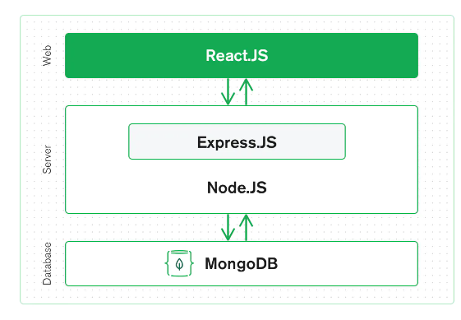
Why MERN Stack is Important?
Although web development technologies are going through exemplary changes with time, it is also inevitable that expectations of users are aloft.
Consequently, developers work hard day and night with their full efficacy to provide a website having better user experience, lesser loading time, and mobile-friendliness
HTML, CSS, and Javascript are the cornerstone of Web development but are no longer enough to fulfill all the above demands
So now we have two technology stacks MERN and MEAN which are developer’s favorite nowadays.

Slide 5
PROJECT DESCRIPTION
My Project is Doctor Appointment services in which every user or patient can book Appointment
After registration you will get mail of your of registration Details.
After registration user can log in through the website using there valid credentials.
As patient Doctor also register themselves
All the details what we are entering are stored in nosql database.
Administrator task includes managing doctors information, patient’s information.
The data can be retrieved easily. The interface is very user-friendly.
To achieve this aim a database was designed one for the patient and other for the doctors which the admin can access.

Slide 6
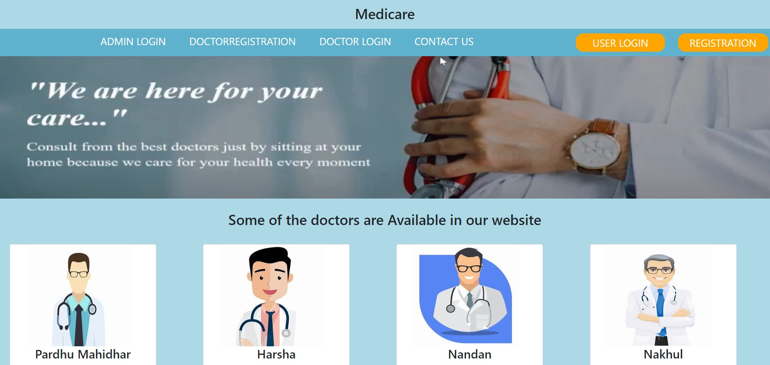
Home page

Slide 7
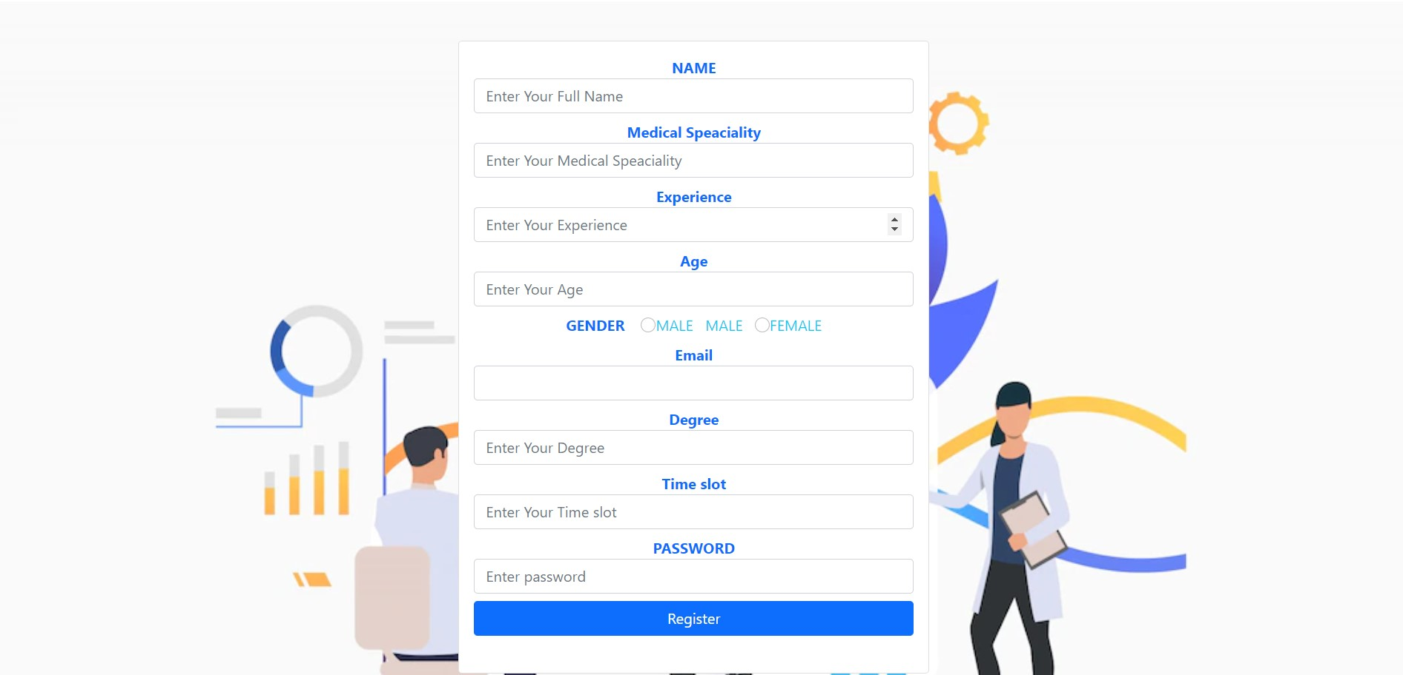
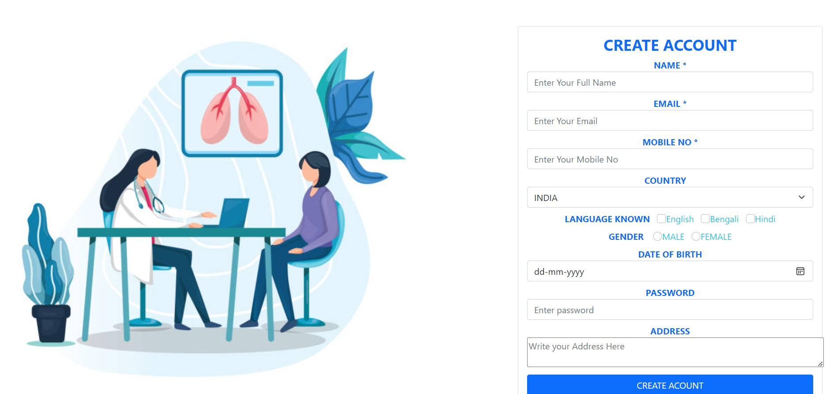
Doctor and user registration
After registering here. You will receive Mail of all your details and your Password will be encrypted in that Mail

Slide 8
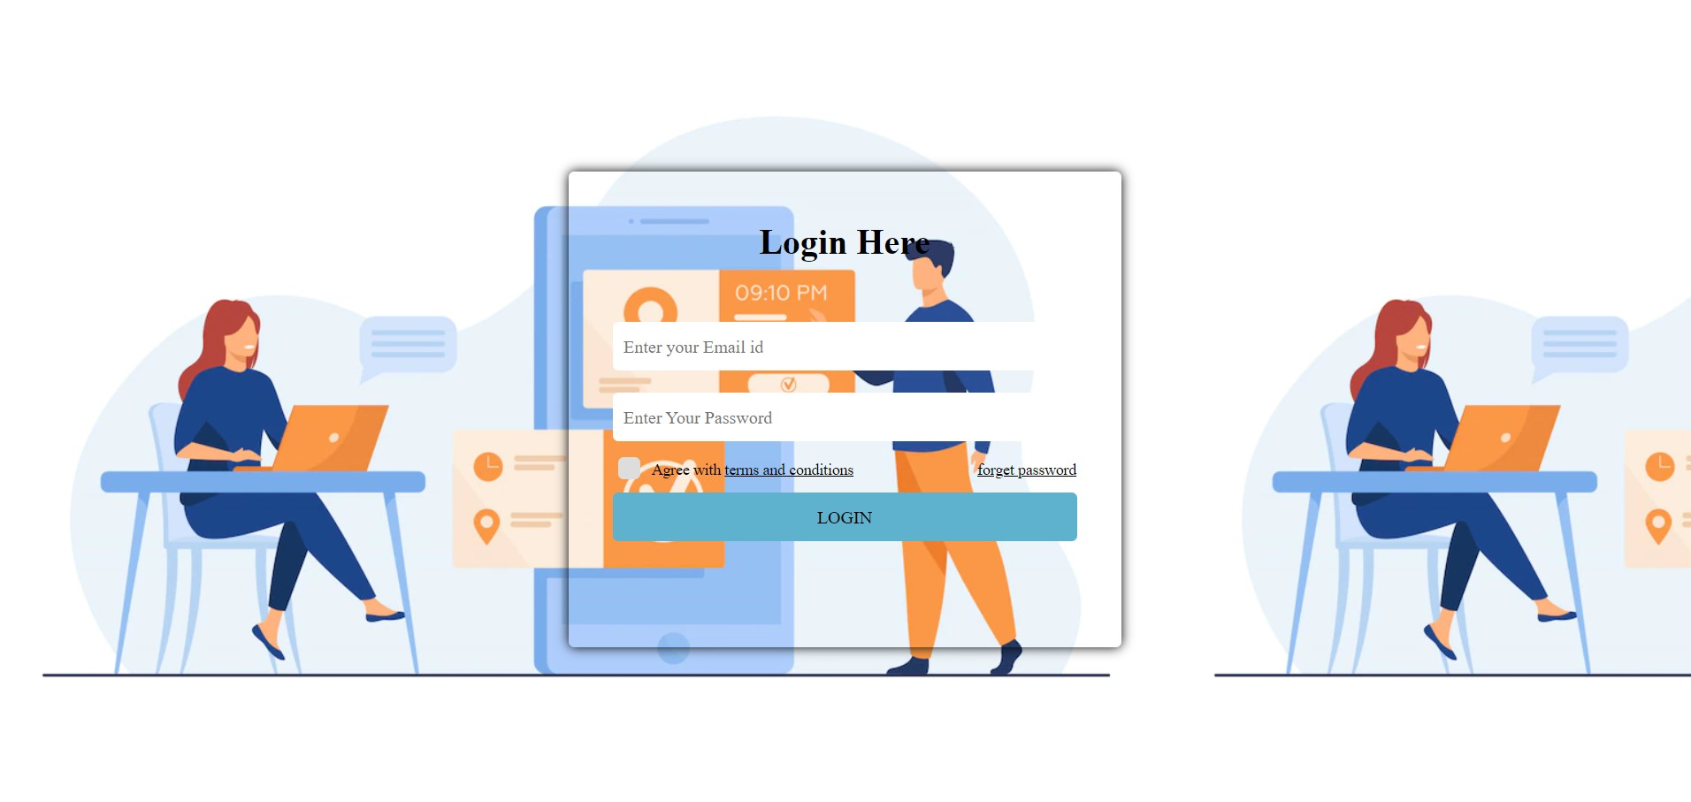
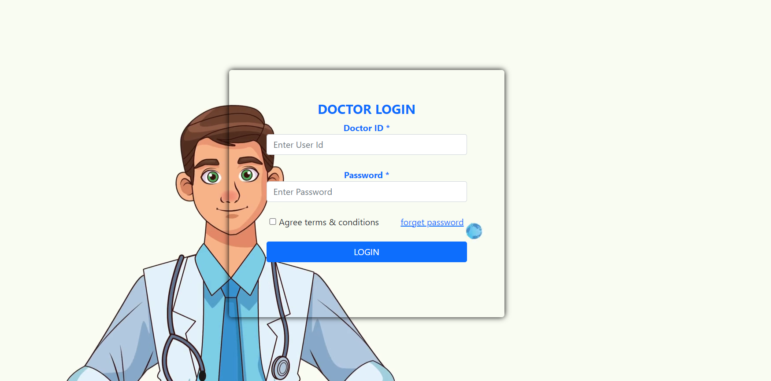
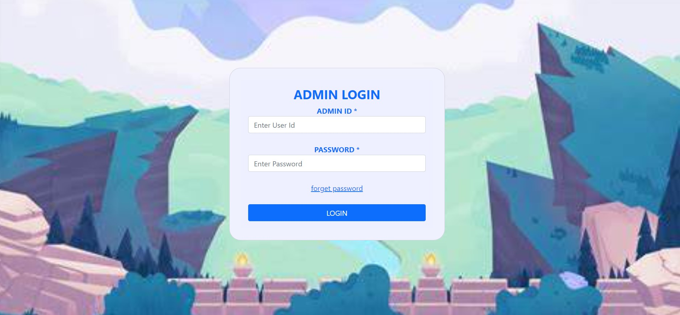
USER, doctor & Admin login
You can login through registered details from here to navigate to respective pages

Slide 9
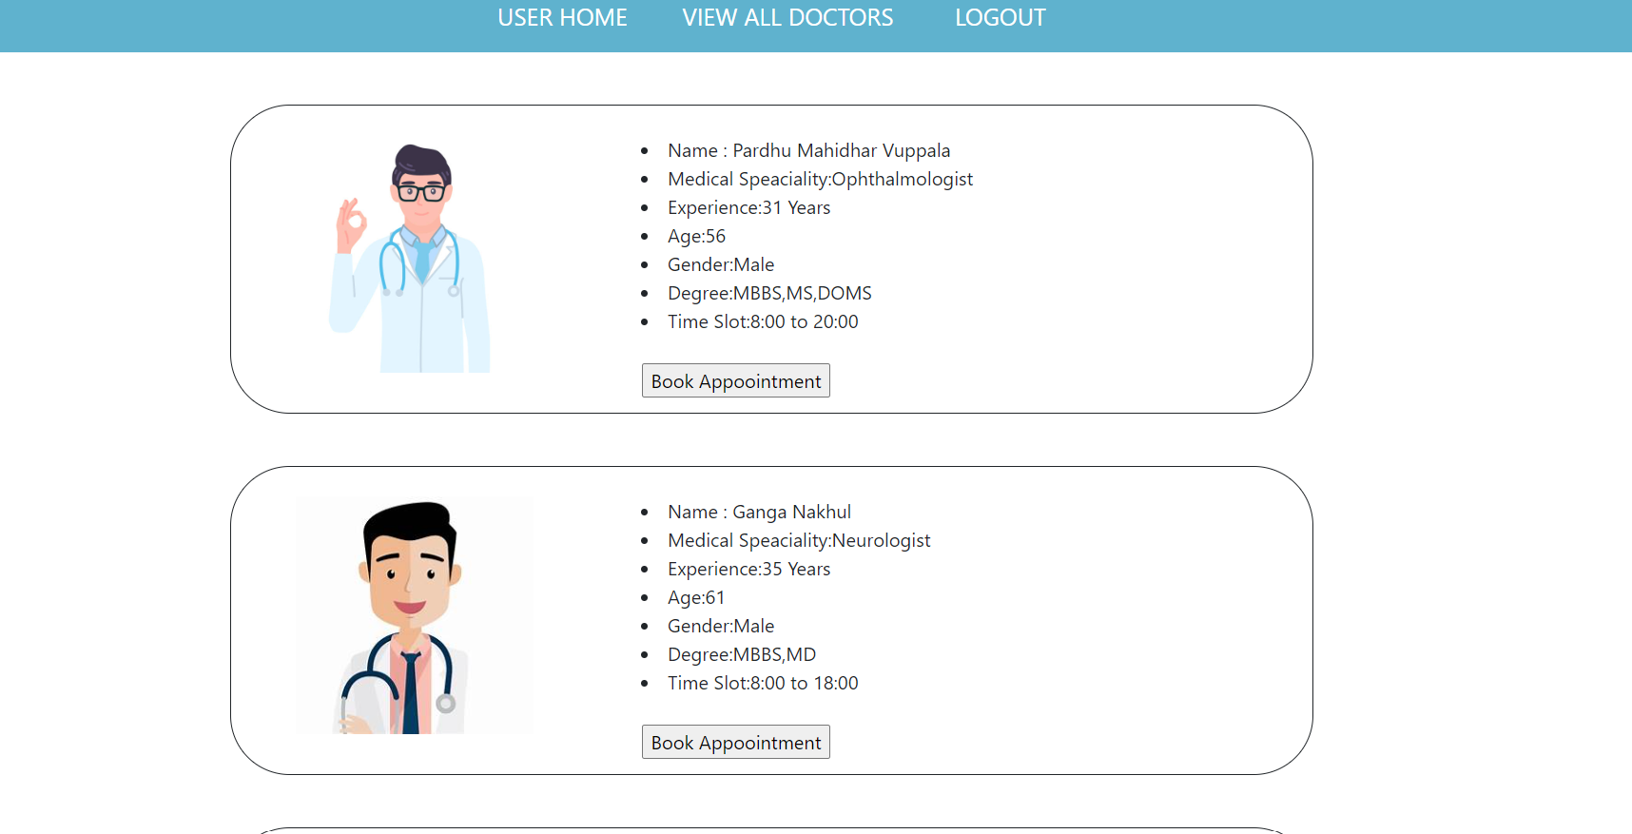
After user login
In this user can book appointment with respect to the problem their facing.
After booking Appointment you will receive Mail of registered details
They is logout button it will take you back to Home Page.

Slide 10
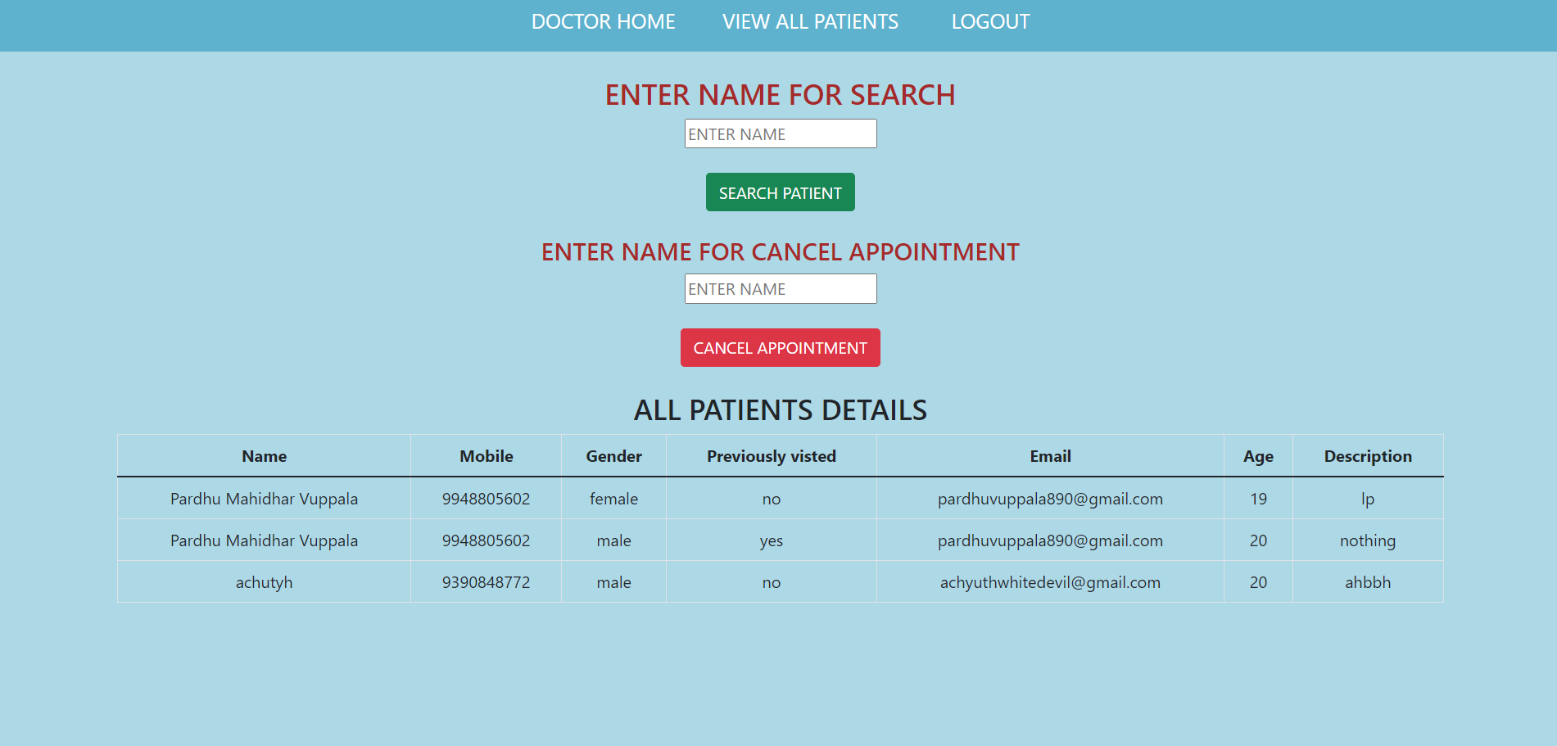
After doctor login
After Doctor Login it will be open in Doctor Home Page , you can see the navbar at the top and clicking on view all patient doctor can see the all the appointment received.
Main thing is that after doctor registration doctor will be added to the doctor’s list in After user login dynamically.
Here Doctor can search Appointment or can cancel the appointment

Slide 11
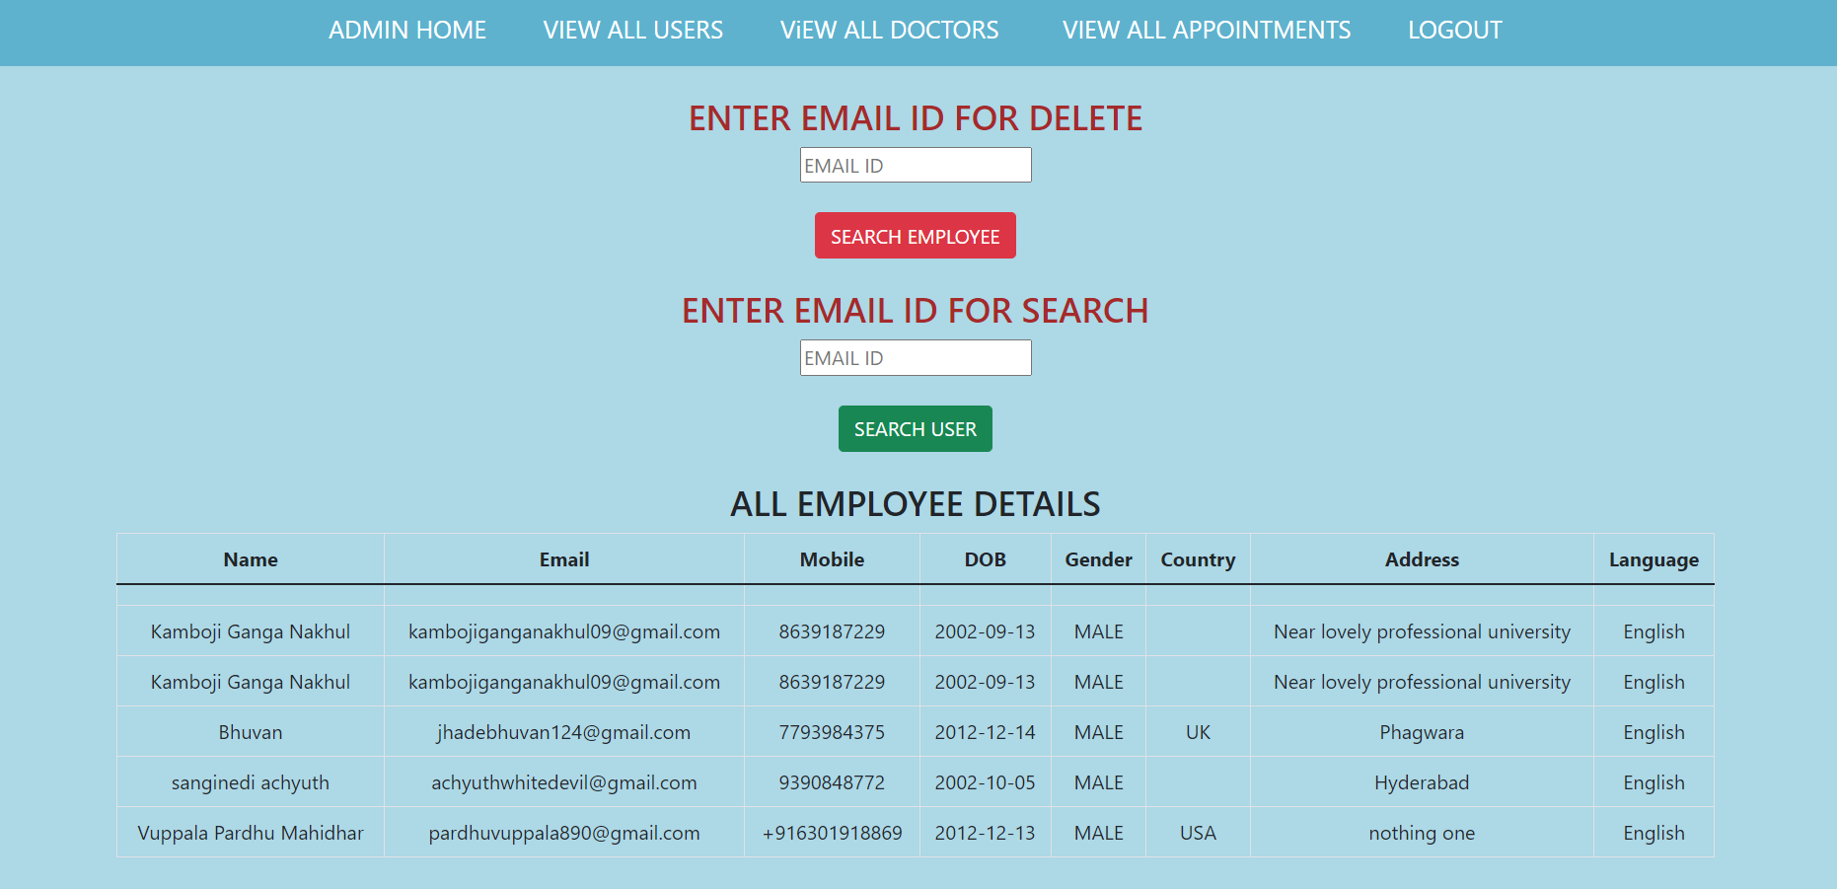
After admin login
After login from admin login we will be landed in Admin Home Page you can see here Admin Home, View All Users, View All Doctor , Logout.
Every Page in this Admin will work properly you can see in video but limited amount of space here I am not pasting the photos here
Admin can Delete the Doctor or User and he can see the details of there registration
They will be search button to search and delete of user and delete
I will be paste the google drive link for the explanation video of the project at the end.

Slide 12
VIDEO GOOGLE DRIVE LINK :

Slide 13


Thank you

